Slide 1


Final Course Project
DeVry University
Fundamentals of Cloud Computing – NETW211 By John Francis

Slide 2
Introduction
Fundamentals of cloud computing is a class that has taught many aspects of what cloud computing can do, as well as administration and networking skills and setting up alerts and actions when something happens. The following slides will demonstrate the skills obtained during this class.

Slide 3
NETW211 Course Project-1
Deploy a Virtual Machine on Microsoft Azure
Connect to the Virtual Machine

Slide 4
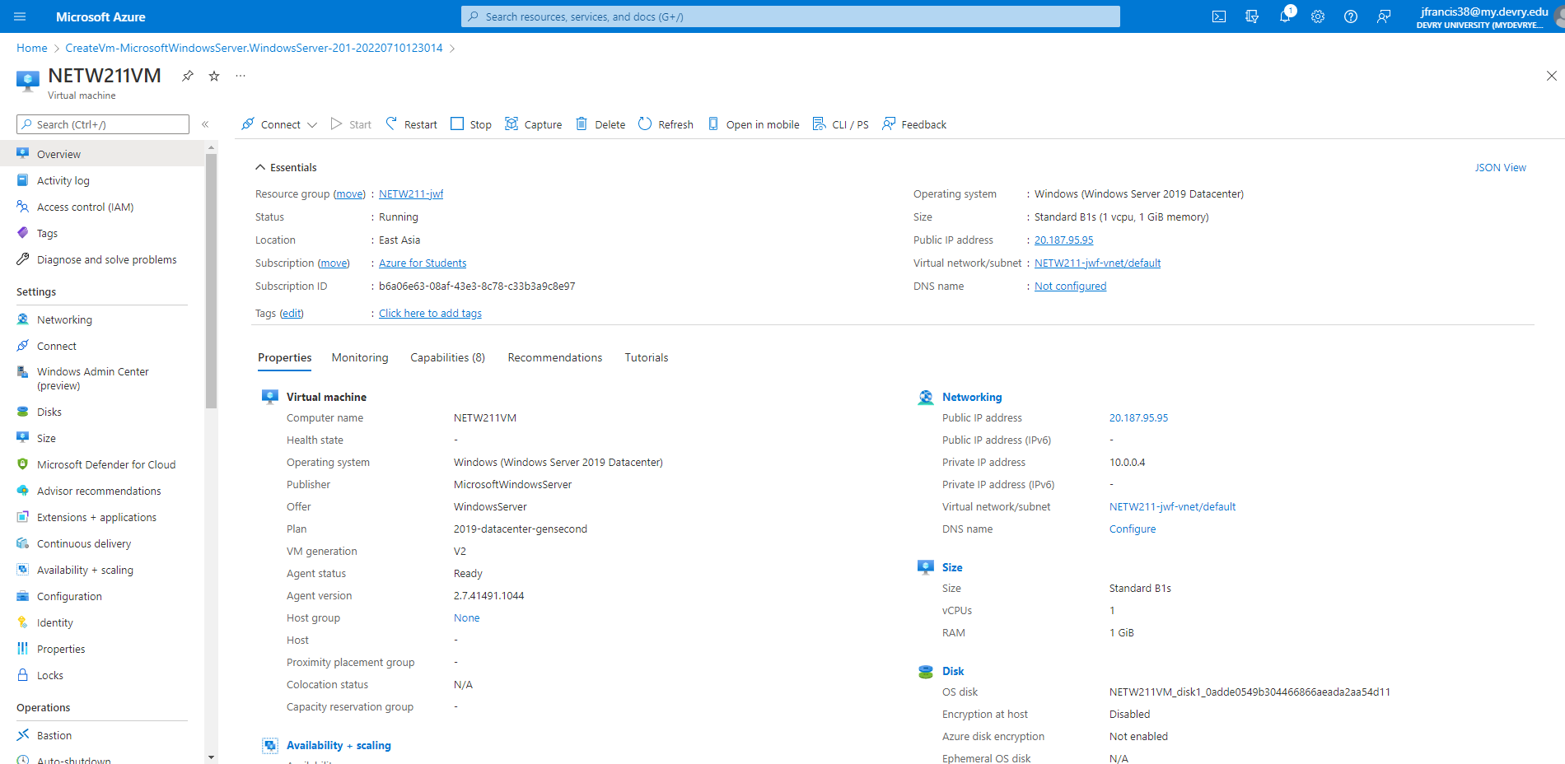
Deploying a VM in Azure
This screenshot should show the NETW211VM page with information such as the resource group name, subscription, public IP address, etc.

Slide 5
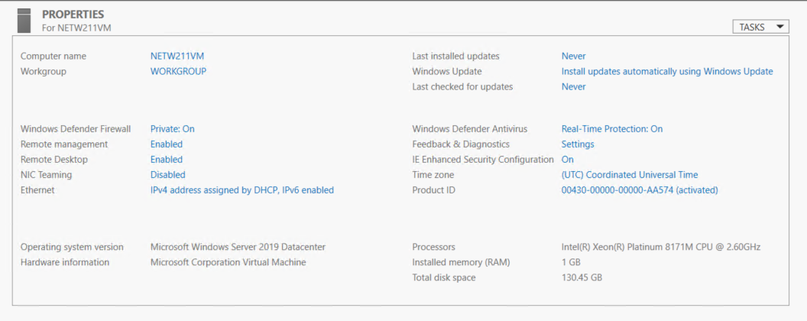
Connecting to the VM
This screenshot should show the PROPERTIES for NETW211VM page, with the computer name, operating system version, hardware information, etc.

Slide 6
NETW211 Course Project-2
Create a Virtual Network with 2 subnets
Deploy Virtual Machines to the Networks
Verify connectivity between Virtual Machines

Slide 7
Creating a VNet with Two Subnets
1. With a /24 network prefix, how many usable IPv4 host addresses are there? [hint: you learned this in NETW191]
Answer here: 251
2. Given the answer above, why is the number of available IP addresses for Subnet0 (10.0.0.0/24) or Subnet1 (10.0.1.0/24) shown as 251? [hint: where did the missing addresses go?]
Answer here: The could reserves some of the IP addresses for its own use
1.) 10.0.1.0 – is the network address
2.) 10.0.1.1 – reserved for routing
3.) 10.0.1.2 – reserved for DNS
4.) 10.0.1.3 – reserved for future use, possibly for mapping
5.) 10.0.1.255 – reserved as the broadcast address
References (here are two examples to get your research started):
1. IP Subnet Calculator, https://www.calculator.net/ip-subnet-calculator.html
2. Azure Virtual Network frequently asked questions, https://docs.microsoft.com/en-us/azure/virtual-network/virtual-networks-faq
3. Stactoverflow, https://stackoverflow.com/questions/43298448/why-azure-reserves-first-four-ip-address-of-a-subnet
4.

Slide 8
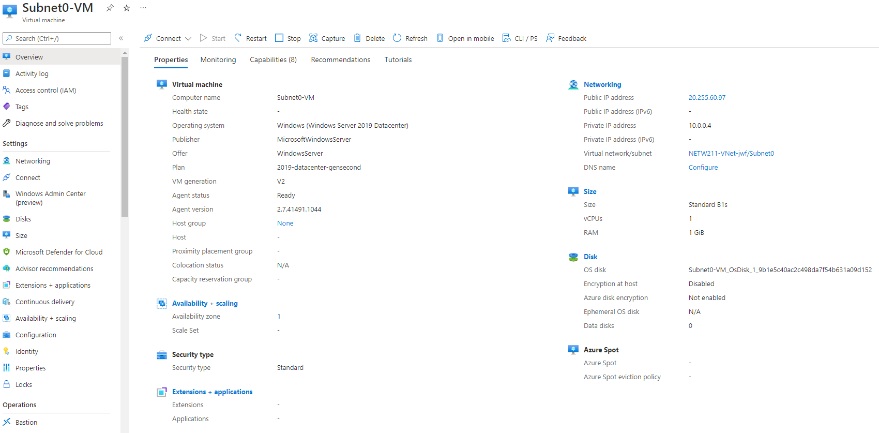
Deploying VMs into Subnets
This screenshot should show the Properties section of the Subnet0-VM page, showing the networking and size information of the VM.

Slide 9
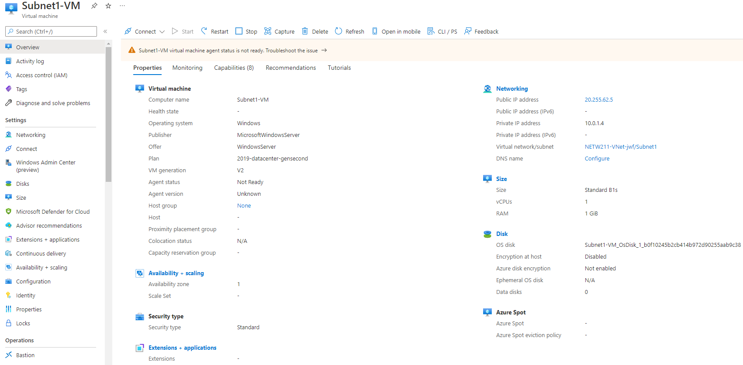
Deploying VMs into Subnets cont’d
This screenshot should show the Properties section of the Subnet1-VM page, showing the networking and size information of the VM.

Slide 10
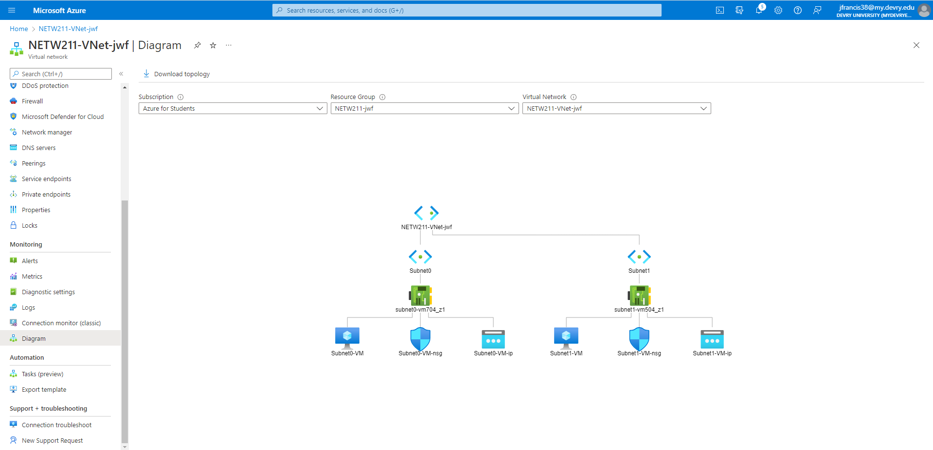
Deploying VMs into Subnets cont’d
This screenshot should show the topology diagram of your VNet (NETW211-VNet-Your Initials) with two subnets (Subnet0 and Subnet1) and one VM in each subnet (Subnet0-VM and Subnet1-VM).

Slide 11
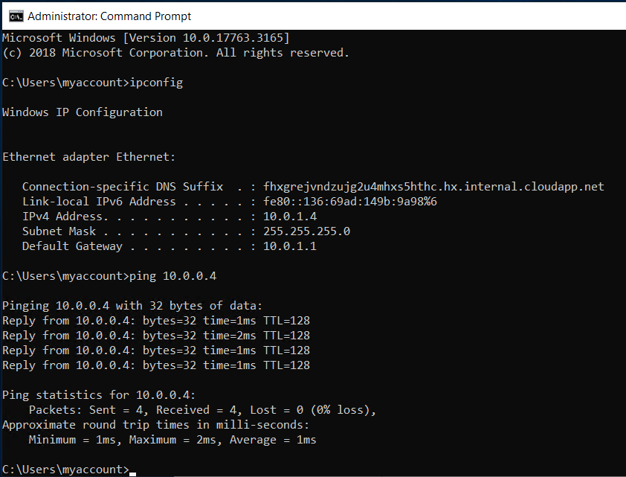
Verifying Connectivity between VMs
This screenshot should show the ipconfig and ping x.x.x.x results in the command prompt window, including the Subnet0-VM – x.x.x.x – Romote Desktop Connection window title.

Slide 12
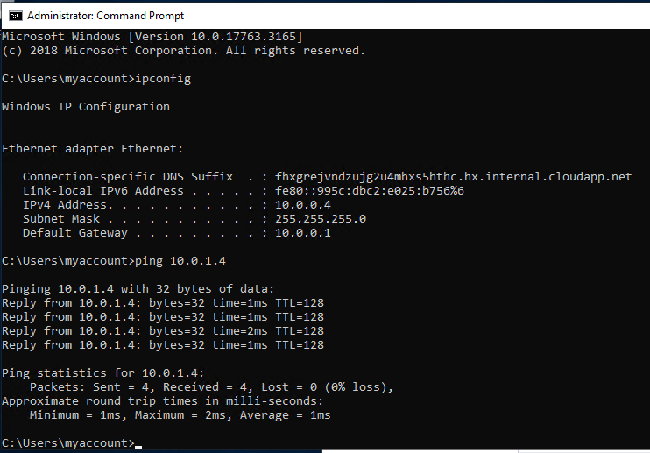
Verifying Connectivity between VMs
cont’d
This screenshot should show the ipconfig and ping x.x.x.x results in the command prompt window, including the Subnet1-VM – x.x.x.x – Romote Desktop Connection window title.

Slide 13
NETW211 Course Project-3
Launch a Virtual Machine
Attempt Connect to Virtual Machine via SSH
Configure Network Service Group (NSG)
Show successful ping

Slide 14
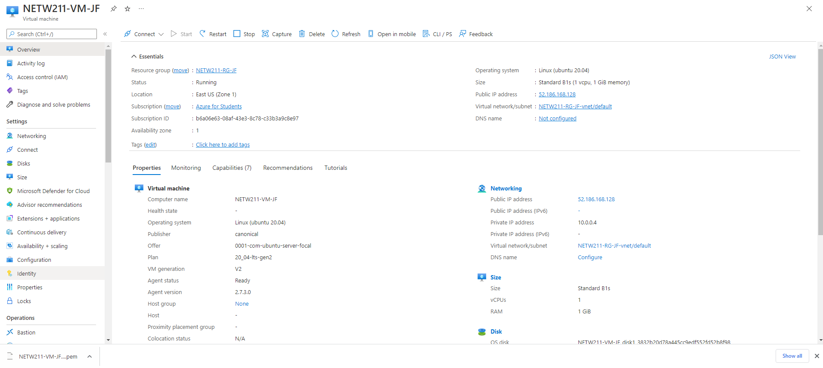
Launching a VM
This screenshot should show the NETW211-VM-Your Initials page, with information such as the resource group name, subscription, public IP address, etc.

Slide 15
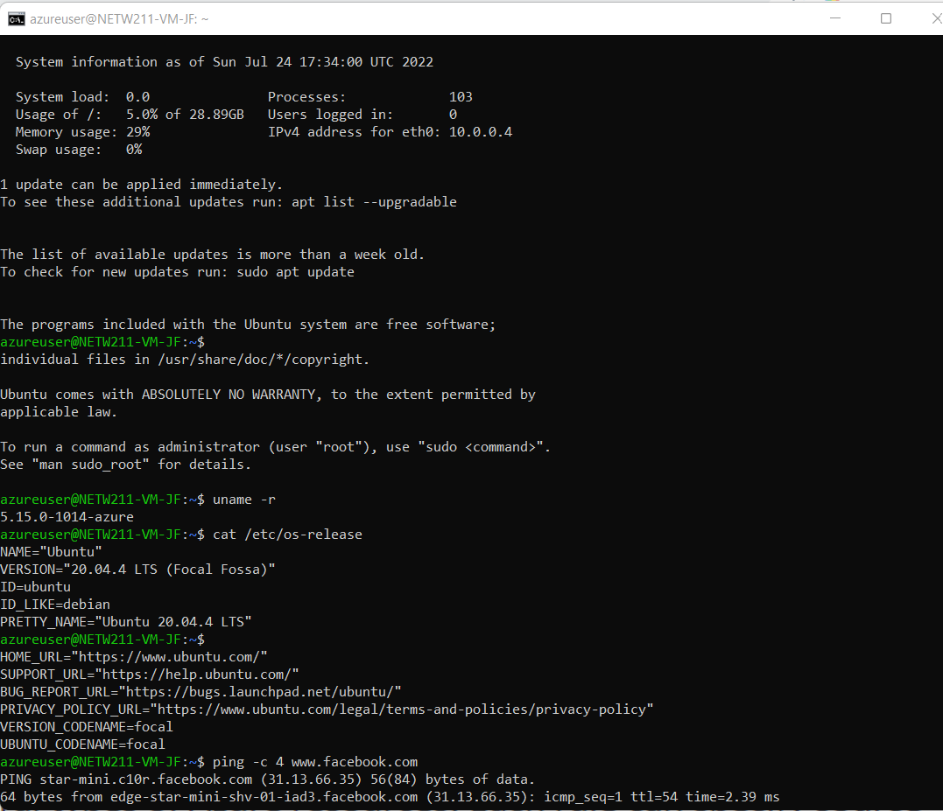
Connecting to the VM
via SSH
This screenshot should show the azureuser@NETW211-VM-Your Initials window showing the IPv4 address of the VM in the Azure cloud.

Slide 16
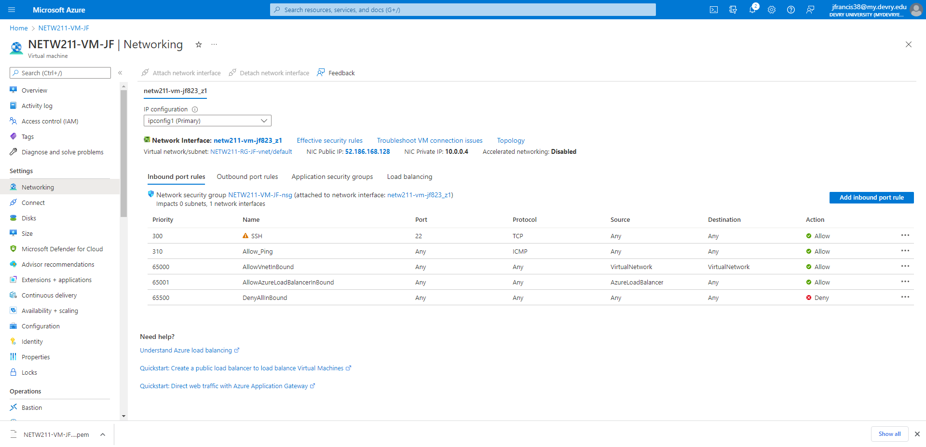
Configuring an NSG
This screenshot should show the Inbound port rules section with the newly added Allow_Ping rule.

Slide 17
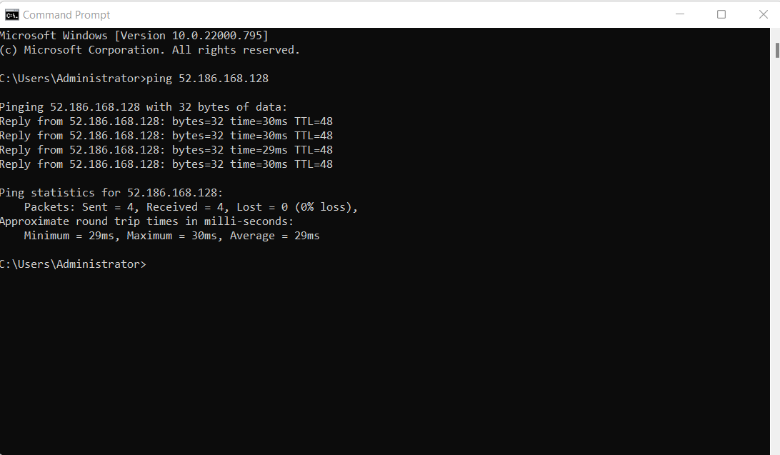
Configuring an NSG
cont’d
This screenshot should show the successful ping result from your local computer to the VM in the Azure cloud.

Slide 18
NETW211 Course Project-4
Uploading and accessing a file
What does the access tier setting do? What are the Azure blob storage access tiers?
Show Original version of the file
Creating Blob Snapshot
Enable Blob Versioning

Slide 19
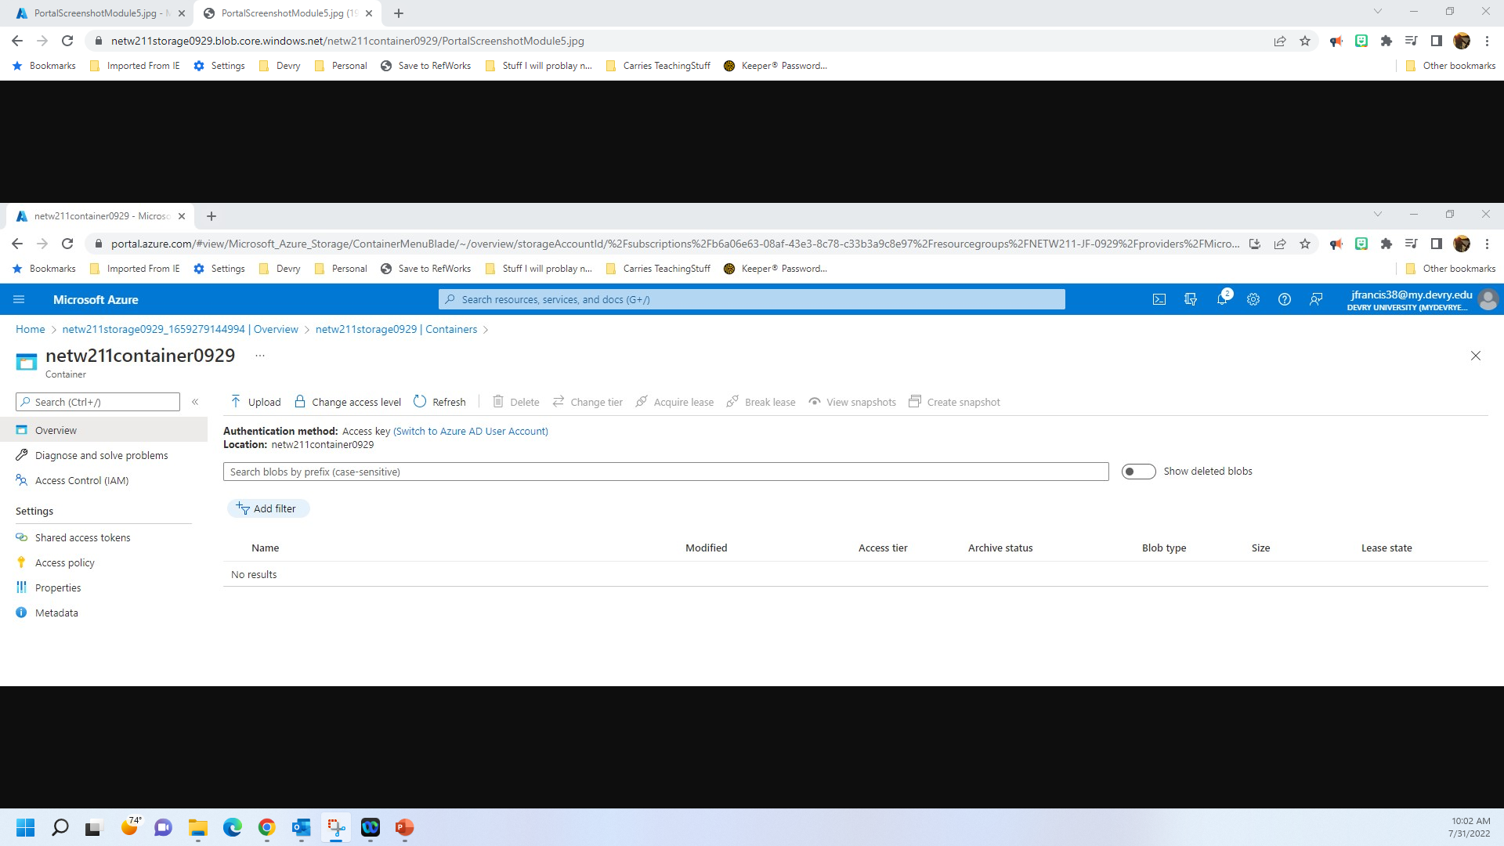
Uploading and Accessing a File
This screenshot should show the browser window with the image uploaded from your local computer and the URL on top of the window.

Slide 20
Question
What does the access tier setting do? What are the Azure blob storage access tiers?
[hint: in the Azure portal, on the Upload blob page, under Advanced, click the ? circle above the Access tier box.]
Answer here:
It allows you to select what type of storage best suits your needs.
Data stored in the cloud grows at an exponential pace. To manage costs for your expanding storage needs, it can be helpful to organize your data based on how frequently it will be accessed and how long it will be retained. Azure storage offers different access tiers so that you can store your blob data in the most cost-effective manner based on how it's being used. Azure Storage access tiers include:
Hot tier - An online tier optimized for storing data that is accessed or modified frequently. The Hot tier has the highest storage costs, but the lowest access costs.
Cool tier - An online tier optimized for storing data that is infrequently accessed or modified. Data in the Cool tier should be stored for a minimum of 30 days. The Cool tier has lower storage costs and higher access costs compared to the Hot tier.
Archive tier - An offline tier optimized for storing data that is rarely accessed, and that has flexible latency requirements, on the order of hours. Data in the Archive tier should be stored for a minimum of 180 days.
Azure storage capacity limits are set at the account level, rather than according to access tier. You can choose to maximize your capacity usage in one tier, or to distribute capacity across two or more tiers.
References (here are two examples to get your research started):
1. Hot, Cool, and Archive access tiers for blob data, https://docs.microsoft.com/en-us/azure/storage/blobs/access-tiers-overview
2. Azure Blob Storage Access Tiers, https://devry.percipio.com/courses/c7ef0333-8560-403f-a004-9c5c843866b0/videos/2658bbe6-ee97-438b-a376-fbb079c3b3a0
3.
4.

Slide 21
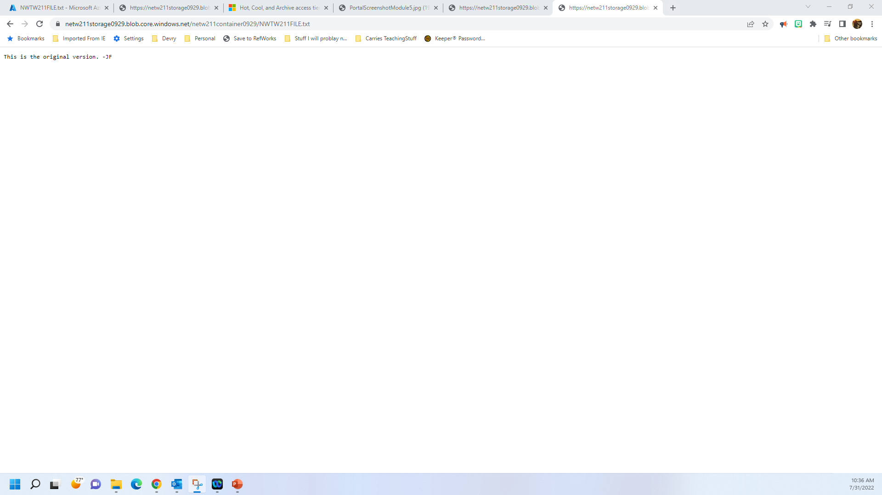
Creating Blob Snapshots
This screenshot should show the browser window with the “This is the original version. –Your Initials” message and the URL on top of the window

Slide 22
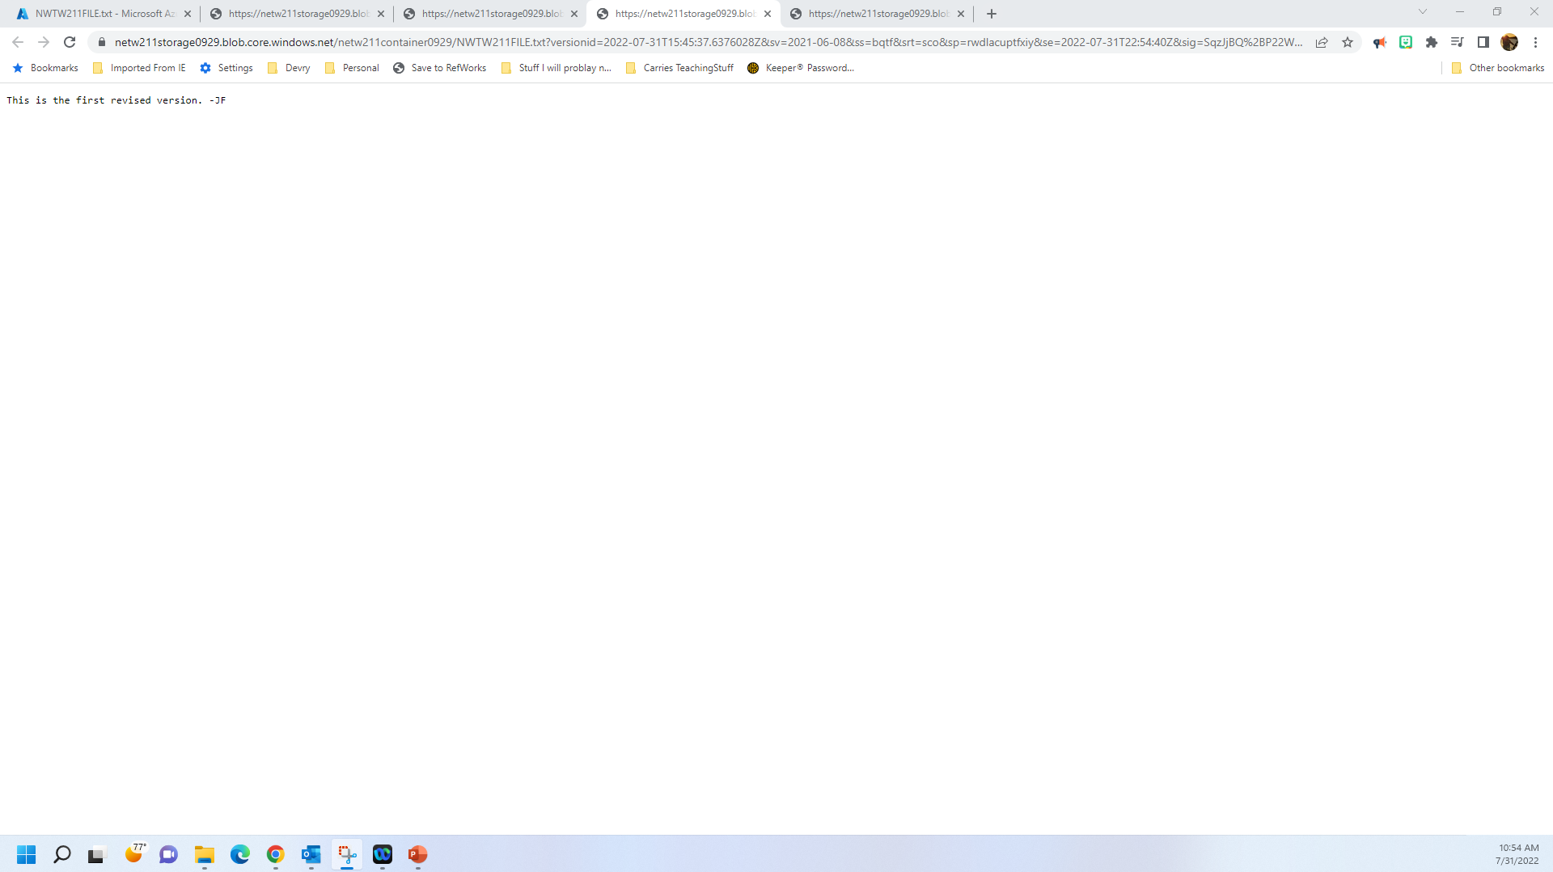
Enabling Blob Versioning
This screenshot should show the browser window with the “This is the first revised version. –Your Initials” message and the URL on top of the window.

Slide 23
NETW211 Course Project-5
Setting Up an Action Group and Notification
Setting up Alert Rules
Testing Alerts

Slide 24
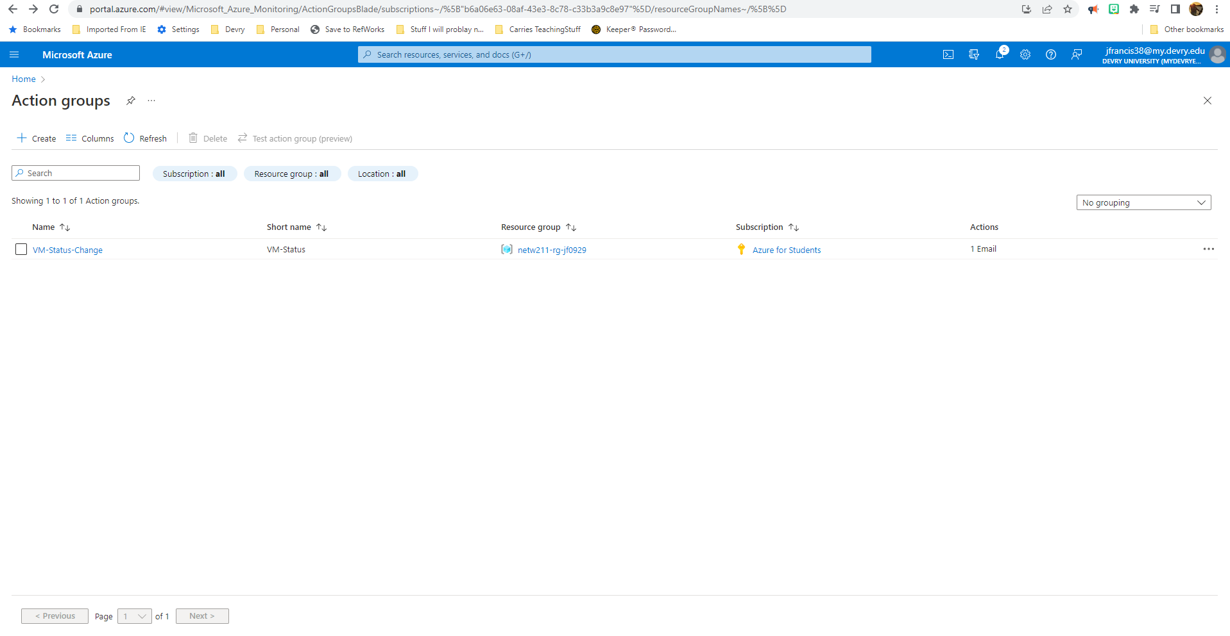
Setting up an Action Group and Notifications
This screenshot should show the “VM-Status-Change” action group on the Manage actions page.

Slide 25
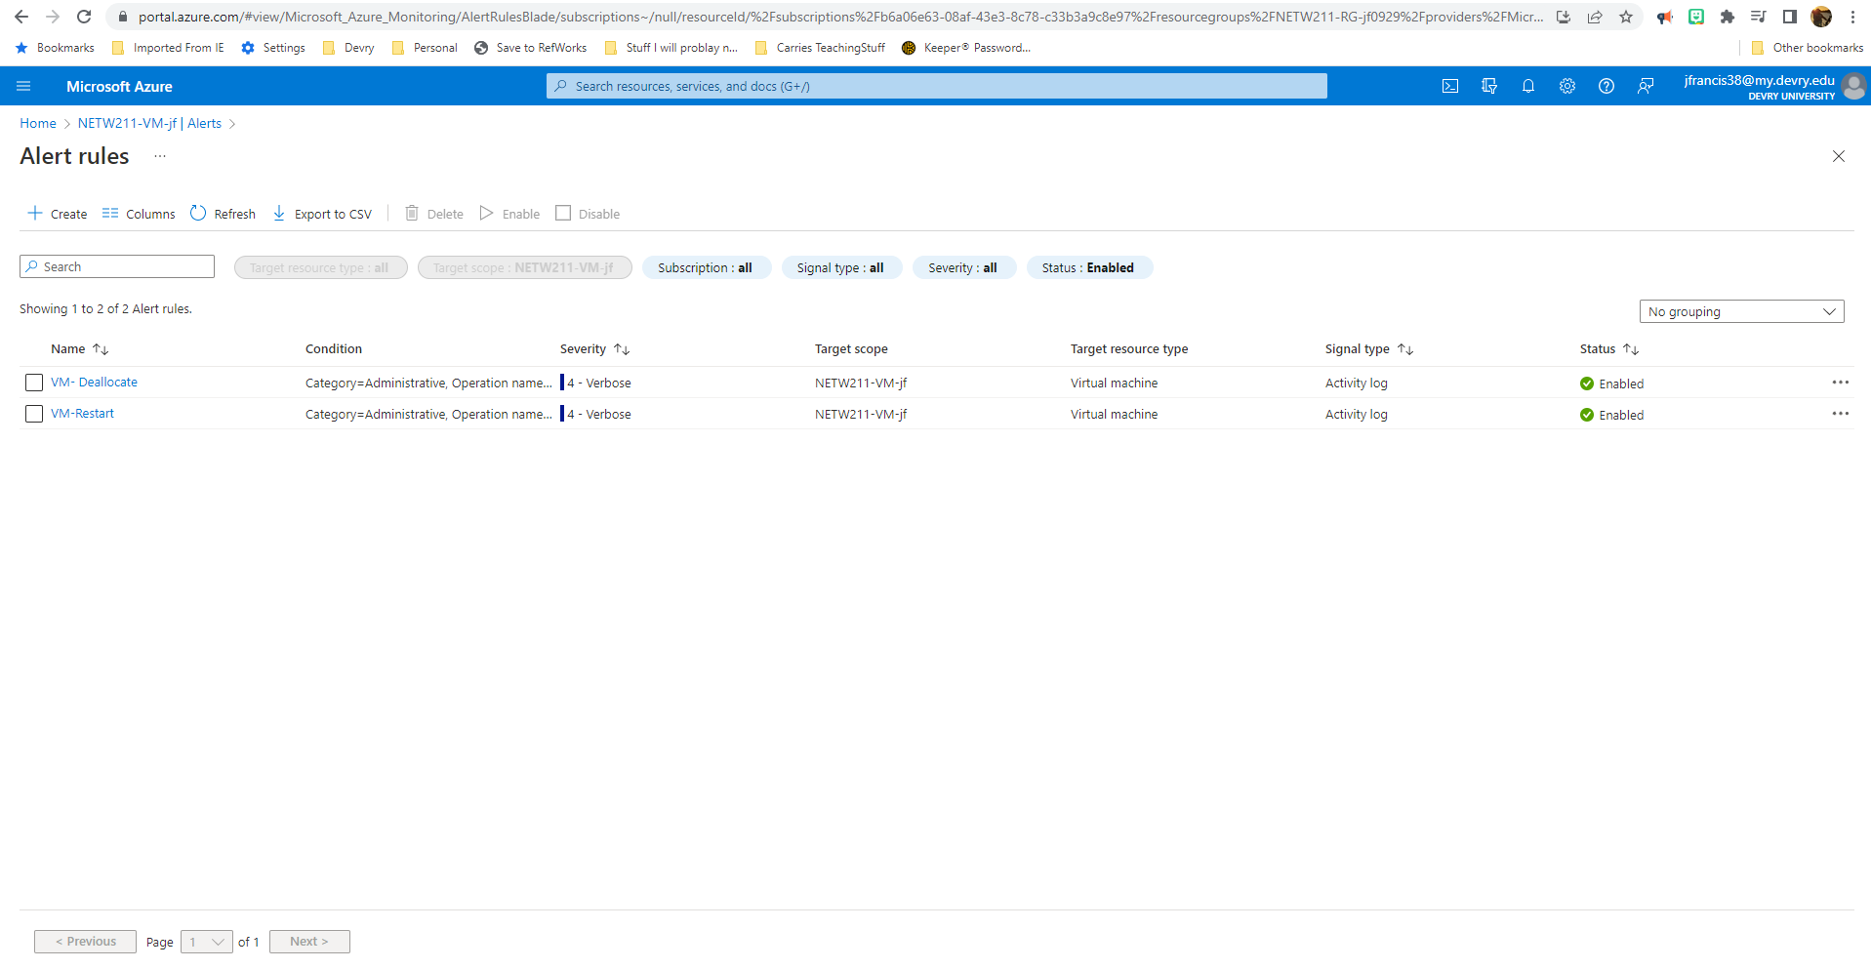
Setting up Alert Rules
This screenshot should show the Alert rules window showing the VM-Deallocate and VM-Restart rules.

Slide 26
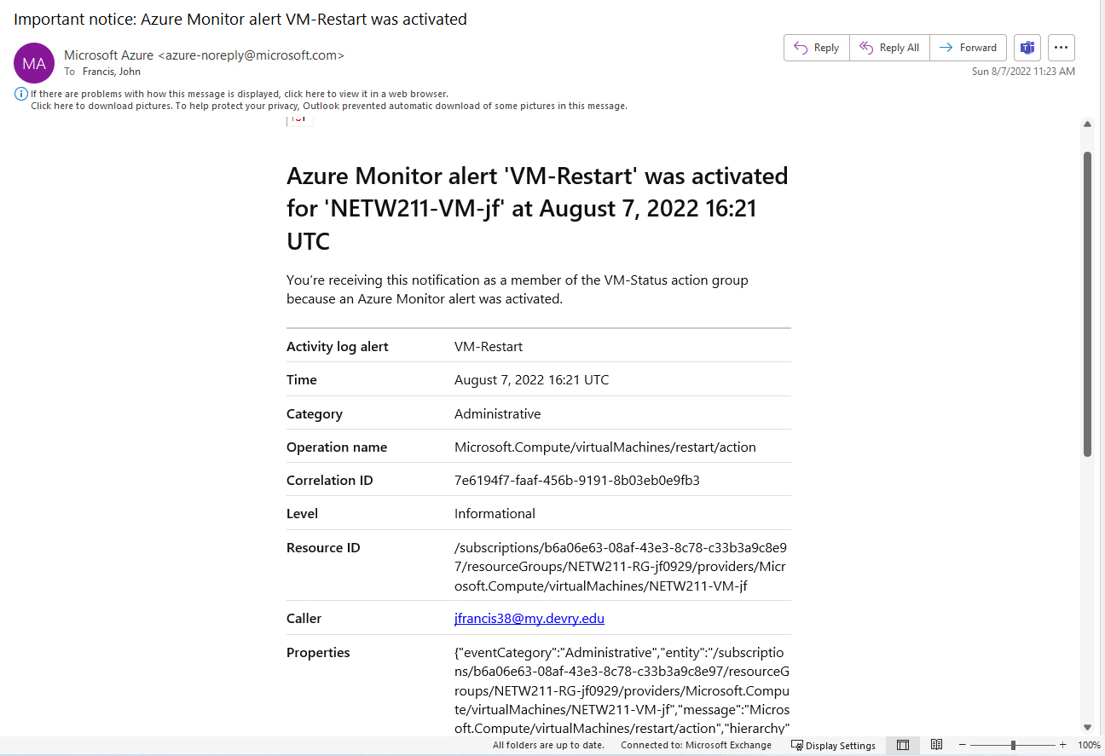
Testing Alerts
This screenshot should show the ‘VM-Restart’ was activated email message with the date and time of the alert.

Slide 27
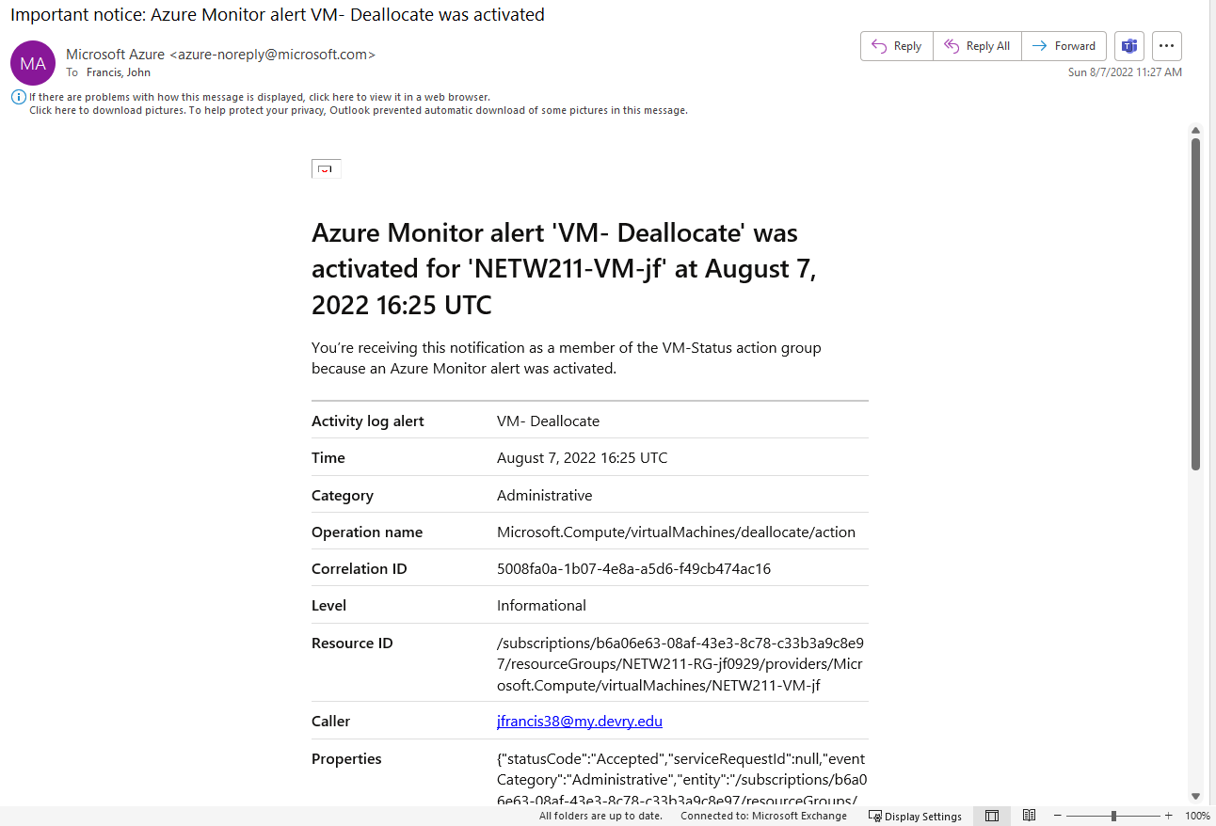
Testing Alerts cont’d
This screenshot should show the ‘VM-Deallocate’ was activated email message with the date and time of the alert.

Slide 28
Challenges in the project.
Cybersecurity can be a big concern with cloud computing, and I was able to overcome some of the challenges by learning how to configure the network service group
Maintenance is another challenge I experience and learned how to help the resources with rules and alerts.

Slide 29
Career skills obtained during this course
Hardware virtualization
Cloud infrastructure
Cloud security
Cloud storage
Cloud migration
Capacity planning
Performance monitoring

Slide 30
Conclusion
This course taught me the fundamentals of being able to work with cloud computing including deployment of virtual machines, resource groups, security, storage and migration. The attached slides have proved I have confidence to be able to perform actions and maintain the resources available including horizontal or vertical scaling of the network and resources. This class was a great learning experience and taught me new terminology and technology as more companies are moving to Platform as a Service, Infrastructure as a Service and Software as a Service.

